Slide 1
Week 1

Slide 2
Math Corner
1. Draw this shape.
2. Tell the name of the shape.
3. Tell how many sides.
Let’s Talk!
How could I count from 1 to 10 frontwards and backwards?

Slide 3
Math Corner-
1. Draw this shape.
2. Tell the name of the shape.
3. Tell how many sides.
Let’s Talk!
How many more dots do I need to make five?

Slide 4
Math Corner
1. Draw this shape.
2. Tell the name of the shape.
3. Tell how many sides.
Let’s Talk!
How many dots do you see?
How do you know? Can you see them another way?

Slide 5
Math Corner
1. Draw this shape.
2. Tell the name of the shape.
3. Tell how many sides.
Let’s Talk!
Are there more cupcakes or more cookies?
How do you know?

Slide 6
Math Corner
1. What shapes do you see?
2. What words can you use describe these shapes?
3. How many do you see? Tell with numbers and words.
3. Which one does NOT belong? Why?

Slide 7
Week 2

Slide 8
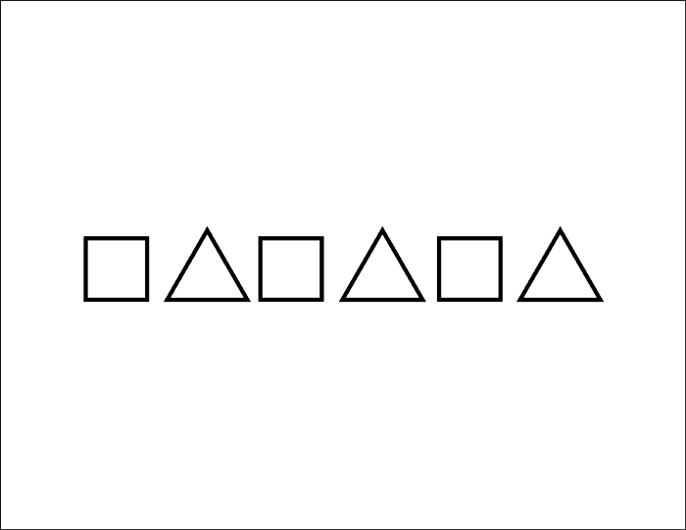
Math Corner
What shapes do you see?
What do you know about each shape?
If this pattern continues, draw what the 7th shape would look like.

Slide 9
Math Corner
Draw each shape.
Label each shape with it’s name.
What do you notice about each shape?

Slide 10
Math Corner
What are the names of these 2 shapes?
What do you know about each shape?
Create an AB pattern using triangles and squares.
Draw a picture of your pattern.

Slide 11
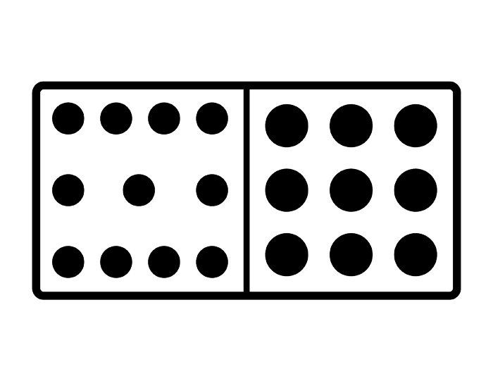
Math Corner
What shapes do you see?
What do you know about circles and rectangles?
How many circles do you see on each side of the domino?
How many circles in all do you see?

Slide 12
Math Corner
Think of your favorite shape. Draw five of them. Show your drawings to a friend. What attributes can you use to describe your shape?
Let’s Talk!
Are there more cupcakes or more cookies? How do you know?

Slide 13
Week 3

Slide 14
Math Corner
What shape do you see?
How many do you see?
Tell with numbers and words.
What color is the LARGEST shape?
What color is the smallest shape?

Slide 15

Math Corner
If I cut a square in half, what two shapes would there be?
Draw to show your thinking
Let’s Talk!
How many dots do you see?
How do you know?

Slide 16
Math Corner
Draw a way to combine two shapes to make a new one.
Let’s Talk!
How many more dots do I need to make 12?

Slide 17

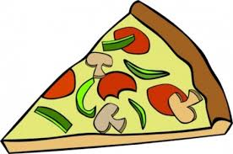
Math Corner
Fill in the blank.
A book is shaped like a ___________.
A slice of pizza is shaped like a ________.
Let’s Talk!
What does zero mean?

Slide 18
Math Corner
Fill in the blank.
A can of peas is shaped like a ___________.
A clock is shaped like a ________.
Let’s Talk!
Are there more cupcakes or more cookies? How do you know?

Slide 19
Week 3

Slide 20

Math Corner
What is a SPHERE?
Tell three things in your class or at home that are in this shape.
Let’s Talk!
Tell how many with numbers and words.

Slide 21
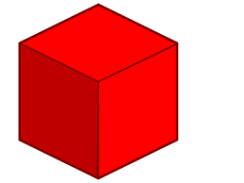
Math Corner
What is a CUBE?
Tell three things in your class or at home that are in this shape.
Let’s Talk!
How many dots do you see?
How do you know?

Slide 22
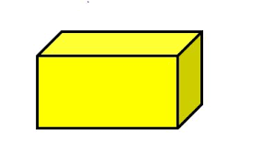
Math Corner
What is a RECTANGULAR PRISM?
Tell three things in your class or at home that are in this shape.
Let’s Talk!
How many more dots do I need to make five?

Slide 23
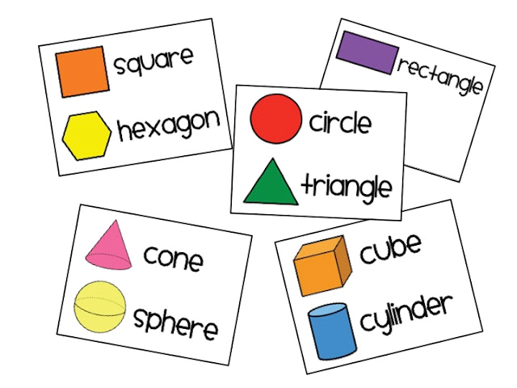
Math Corner
What is the difference between a 2 dimensional shape and a 3 dimensional shape?
What is the difference between a square and cube?

Slide 24
Math Corner
Fill in the blank.
A ball is shaped like a ___________.
A refrigerator is shaped like a ________.
Let’s Talk!
Are there more cupcakes or more cookies? How do you know?

